Slide 1
Introduction to Human Sciences
Literature Module
Lecture 1: What is Culture

Slide 2
Why do I need the Humanities
The cumulative and individual experience of being a human
Equally human? Some more, perhaps?
Who, why, where are more/less human
The modern citizen-subject – autonomous, free, free-willed, inalienable rights

Slide 3
Political subject
Psychological, emotive, rational, economic entity
The Humanities are a continual accrual of the entirety of this human experience
We exist as individuals, as social bodies, as concepts

Slide 4
Humanities are a study of the experience of being all of these
Individuals, social bodies, concepts
Think critically, creatively, imaginatively
Ask questions and interrogate existing conditions of being a human

Slide 5
No separation between human society and the Humanities
Encounter other imaginations, ways of being in our everyday
A good novel tells a story of other times/societies/genders/races/ages/realities
The Humanities are essential training in finding a language to ask questions about these “others” and “us”

Slide 6
Fiction allows you to imagine hobbits, elves, rings, wandering wise men, magic hammers, iron suits, dwarfs, evil and good
Humanities – those orcs look like black people!! Was Tolkein racist?!! Debatable.
To be evil is be/become dark (non-white perhaps?)

Slide 7
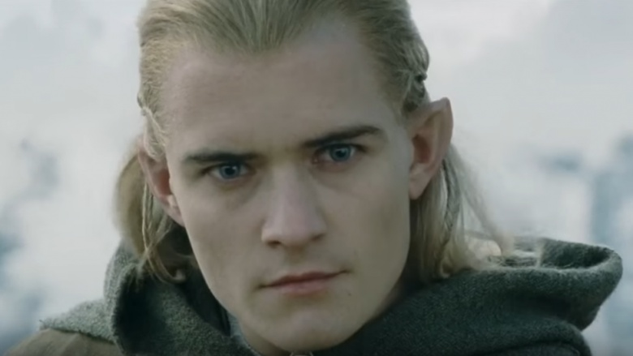

Some Good guys

Slide 8
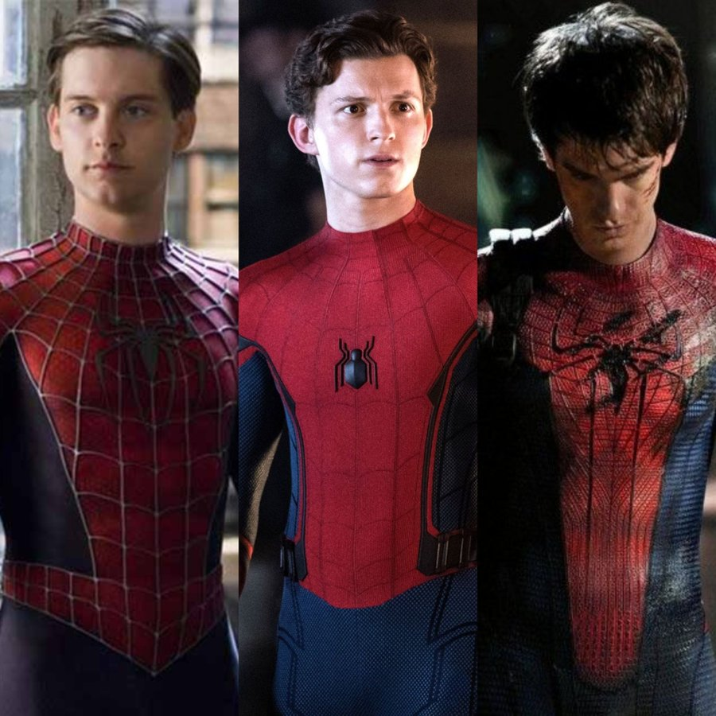
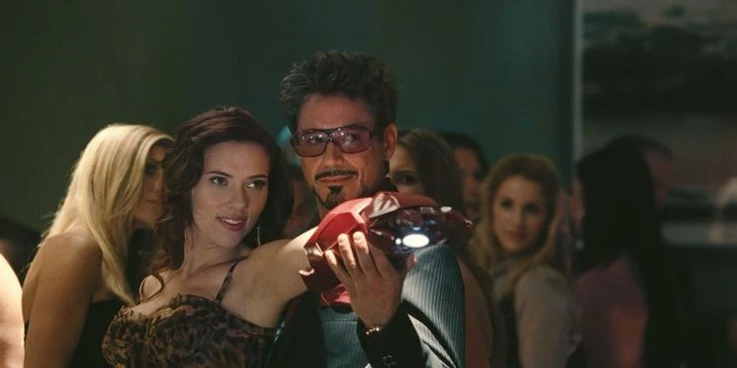

Slide 9
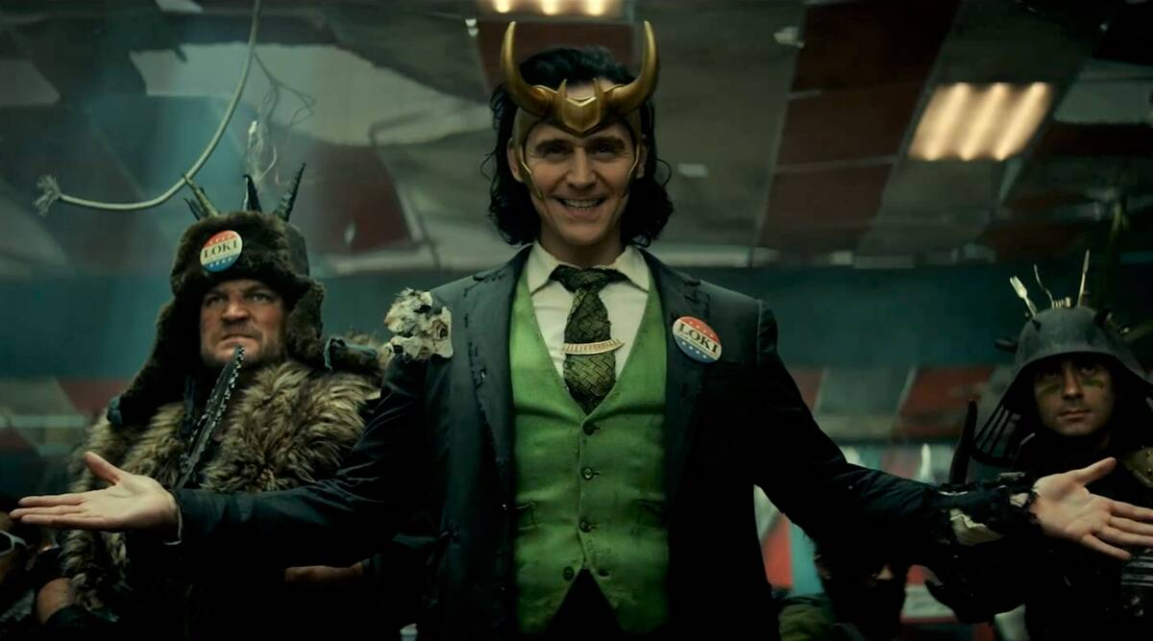
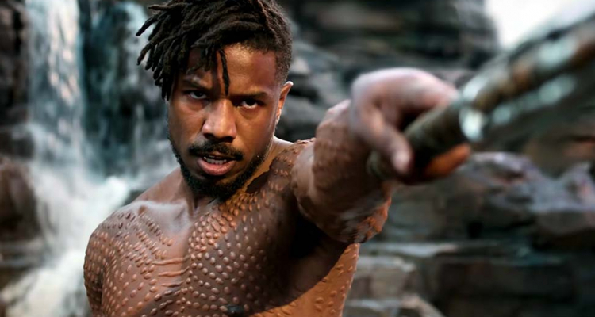
Some bad ones

Slide 10
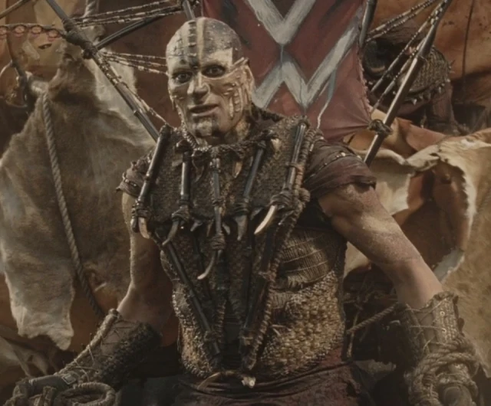
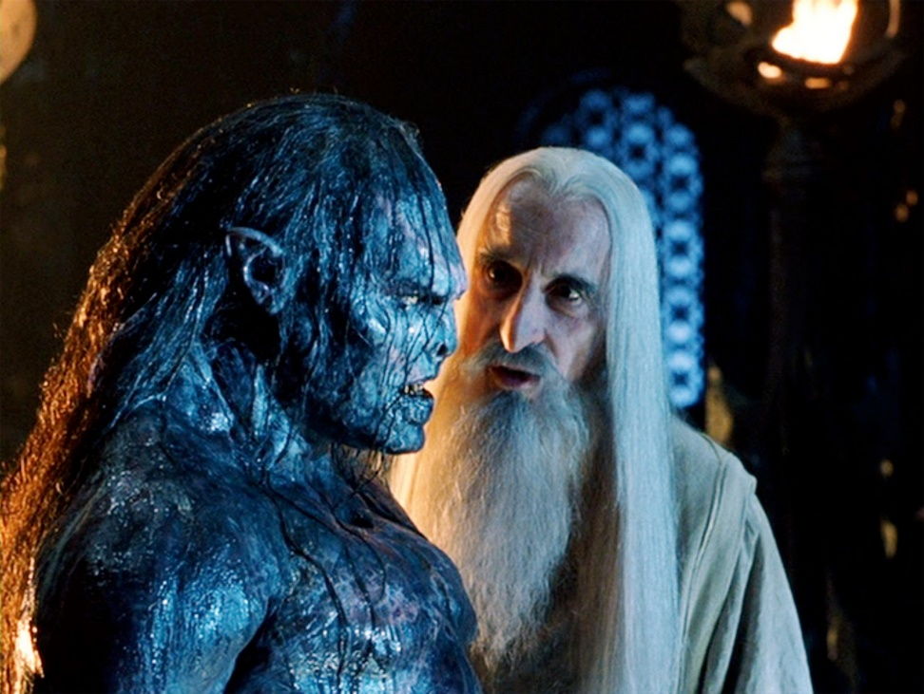

Slide 11
What is Culture?
Relationship between human experience, everyday life, social relations and power
Particular cultural practices include but are not restricted to literary production, visual and aural production, art and artisanal practices, pop culture and ephemera.

Slide 12
Culture is the everyday (shaadi dancing, flowers in hair) and the long-forgotten (Mohenjo-Daro)
The massive (Ganga-Jamuna, Taj Mahal-Mahabalipuram, karma) and the minute (touching of head with a finger)
Continually produced and reproduced

Slide 13
Literature: Written works, especially those considered of superior or lasting artistic merit (Oxford Dictionary)
Understanding culture requires understanding a specific conjunction between the ideal of all human achievements and values; a common practice and a way of life commonly understood by members of a society and the new, creative, and untested. (Raymond Williams, Stuart Hall)

Slide 14
Raymond Williams (Culture and Society)
Late 18th century. Industrial Revolution
Industry -- as an institution
Democracy – as a political word, not just theoretical or literary
Class – modern social structure we recognise as class (Lower orders/class, middle class, working class). Class, not rank.
Art – a special kind of truth. Imaginative, unique. Aesthete/aesthetics. Talent, genius

Slide 15
Culture – meant a “natural growth.” training smthg. to grow – including training a human being. Comes to mean a thing in itself
a general state of mind/being. Close to perfection
General state of intellectual development in society as a whole
A body of arts – this dance/music is “our” culture
A whole way of life/physical and spiritual. Comes to be a battleground of shame/pride

Slide 16
Distinguish three levels of culture
the lived culture of a particular time and place, only fully accessible to those living in that time and place.
recorded culture, of every kind, from art to the most everyday facts: the culture of a period.
the factor connecting lived culture and period cultures, the culture of the selective tradition

Slide 17
Where is Culture?
It is in the organization of production of society, the structure of the family, and institutions which express or govern social relationships, the characteristic forms through which members of the society communicate. Cultural artefacts cannot then be read only in aesthetic terms.

Slide 18
To read literary texts with social and historical analyses
Historical circumstances, social traditions, and the media work together to create a cultural milieu in which certain sets of beliefs are either reinforced or questioned in the text

Slide 19
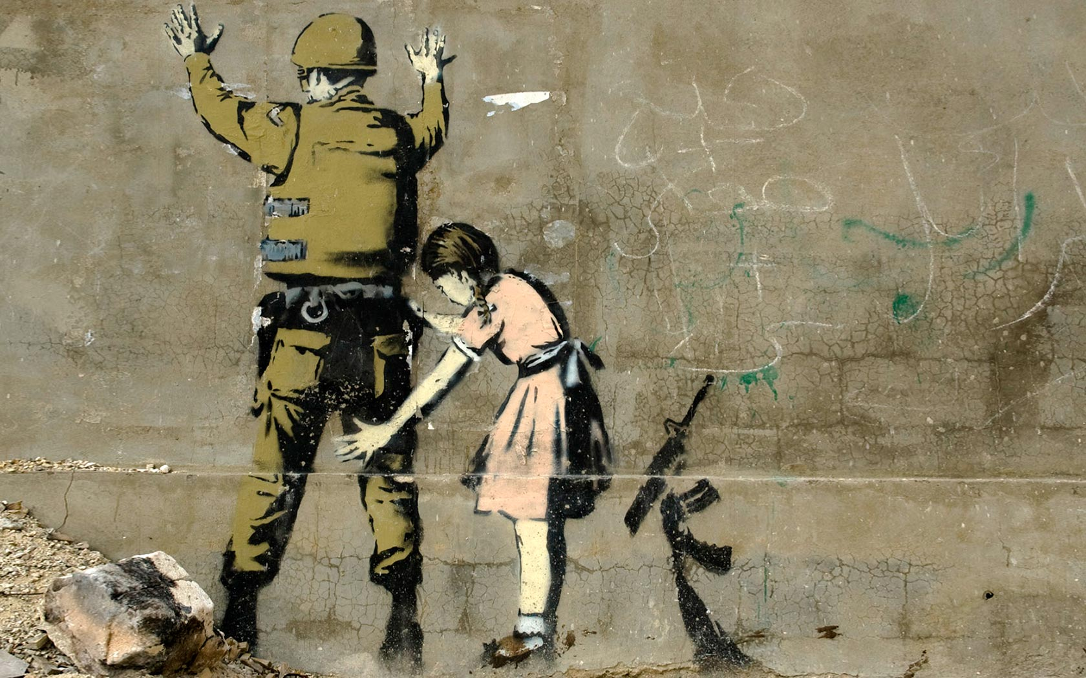
Banksy

Slide 20
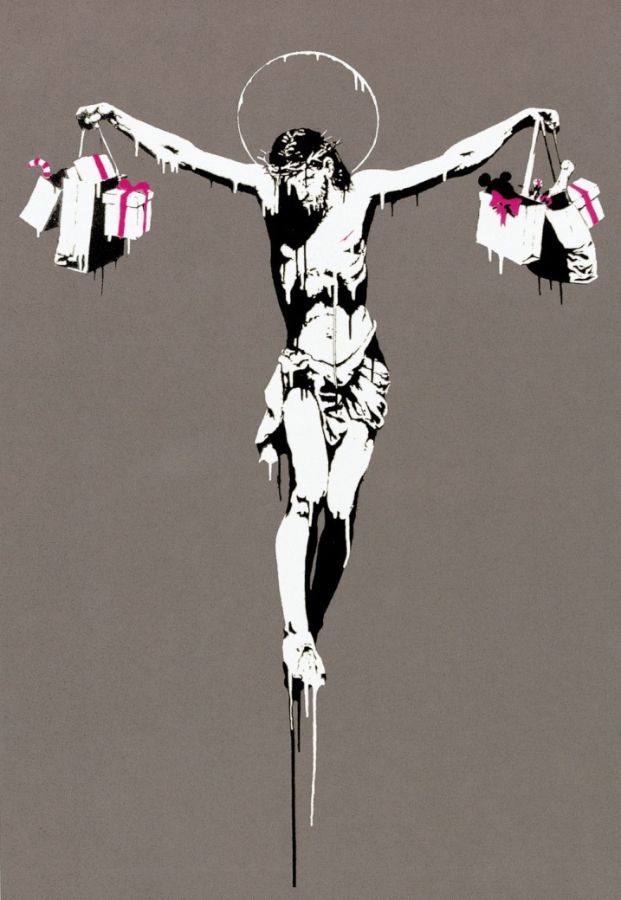

Slide 21
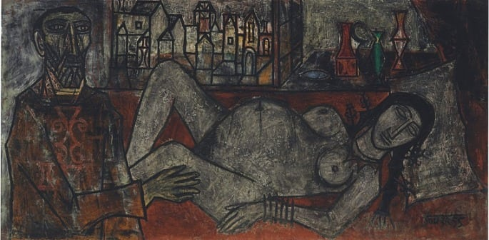
Souza – “Birth” 2015, 3.1 million euros

Slide 22
A few ideas
High artistic/cultural merit vs low culture/literature
Exclusivity of access, control over means of production, rarity
Artist vs artisan, skills vs talent/genius
Distance from the body (Herbert Marcuse)

